Slide 1


ISSS608 Group 5
SGGoldenGoose
User Guide
The journey to search for your Golden Goose starts now

Slide 2


Content Page
01
Introduction
02
Buy
Overview
Price Sensitivity
Time Trend
17
Rent
Overview
Price Sensitivity
Time Trend
32
Mythbusting
Myth 1: Are older houses bigger?
Myth 2: Are some housing types more accessible than others?
Myth 3: Does pricing of new project launch changes overtime?

Slide 3
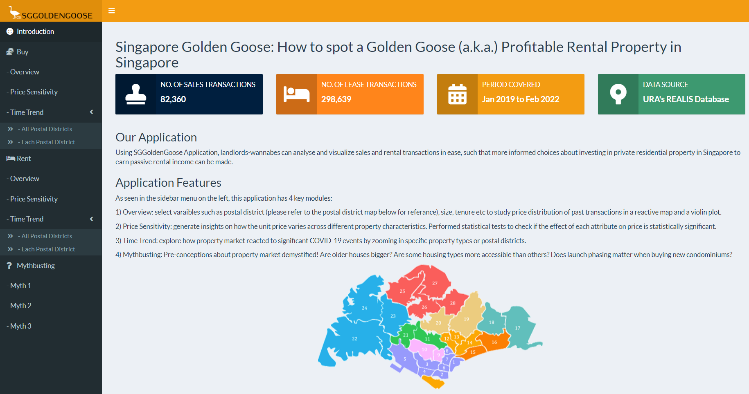

1. Introduction
Short description and overview of the application.
01

Slide 4
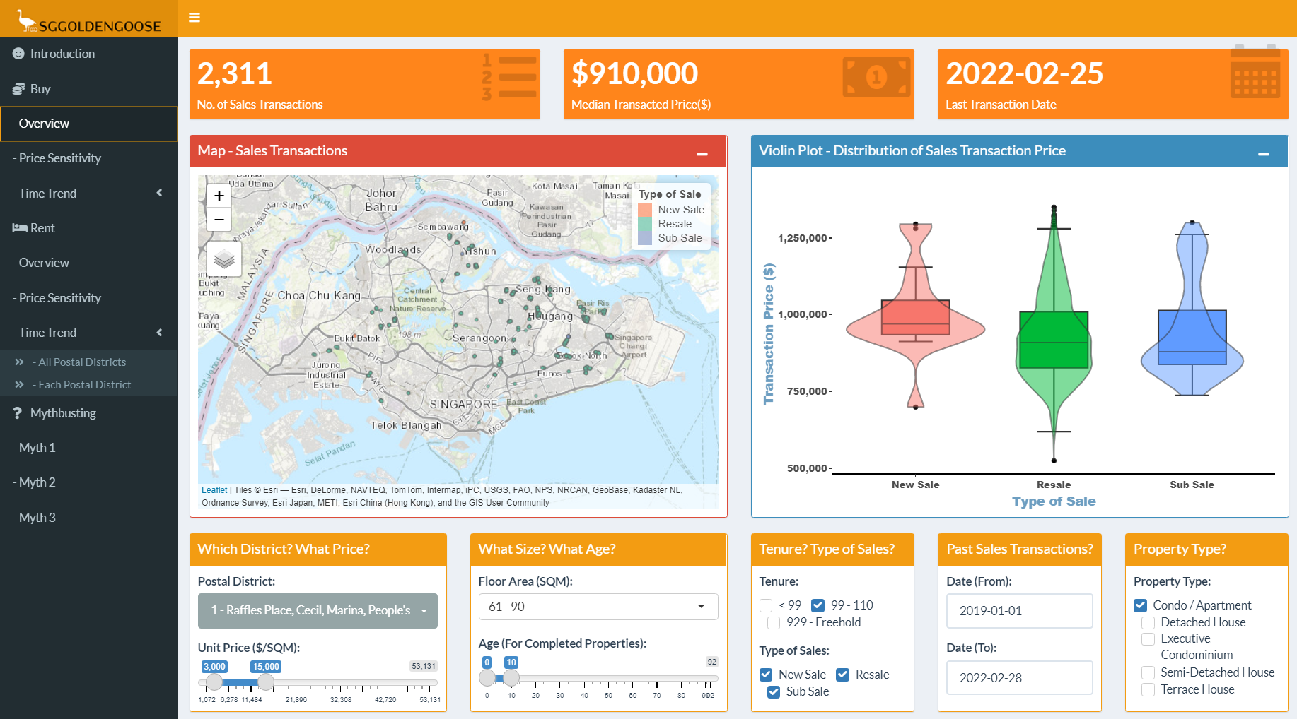
2. Buy
2.1 Overview Tab
This tab allows you to visualize a summary of the sale prices and their distribution (i.e. mean, median etc), customized to your needs and preferences.
021

Slide 5
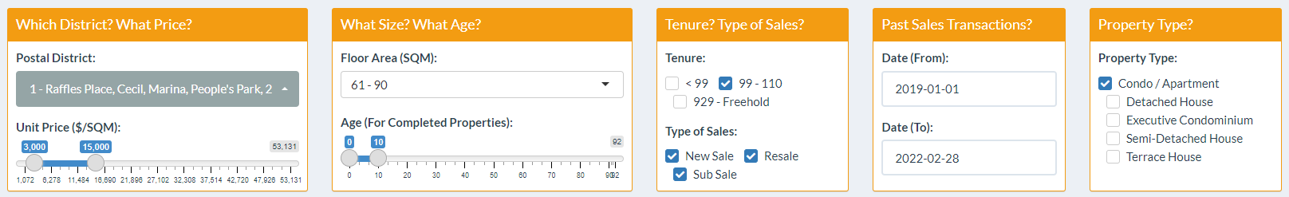

2. Buy
2.1 Overview Tab – User’s interface
1
2
3
4
5
Apply Postal District filter(s) to the sales transaction data. Indicate also the range of Unit Price ($/SQM) of your interest.
Select the range of Floor Area (SQM), and the Age range of your dream property (only for completed properties).
Use the checkboxes to select and filter Property Tenure and Type of Sales.
Indicate date range for past sales transactions.
Finally, let us know what type of property you are interested in buying.
01
03

Slide 6
2. Buy
2.1 Overview Tab – Reactive Visualization (1/3)
1
2
3
Based on your selection criteria, the following values will be populated instantaneously in the three value boxes:
No. of Sales Transactions
Median Transacted Price ($); and
Last Transaction Date captured in the REALIS database that fits your criteria.
01
04

Slide 7
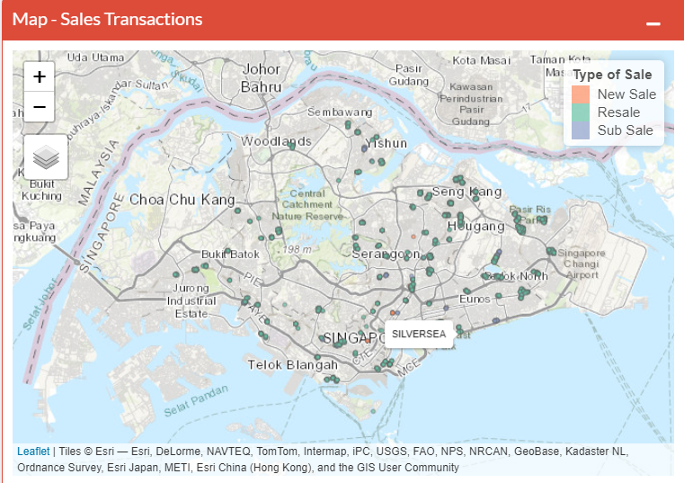
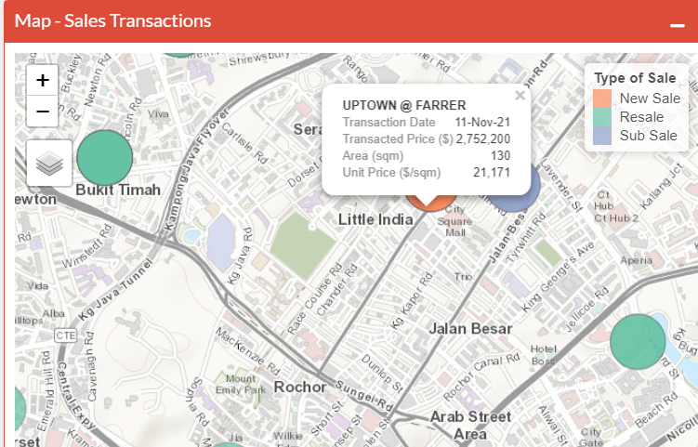
2. Buy
2.1 Overview Tab – Reactive Visualization (2/3)
Based on your selection criteria, dots representing past sales transactions with the following color-coding will appear on the map:
Red : New Sale
Green : Resale
Blue : Sub-Sale
Mouse over the dots to see the property name.
- Zoom and pan into the map to have a closer look at
the property’s exact location.
Click over the dots to reveal the details of the transactions [i.e. Transaction Date, Transacted Price, Area (SQM), and Unit Price ($/sqm)]
01
05

Slide 8
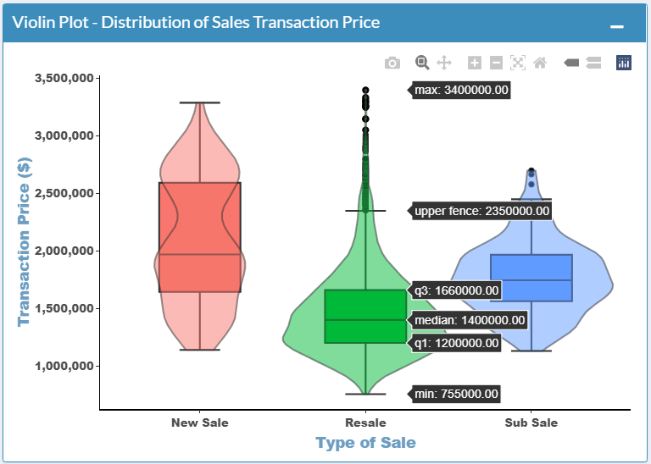
2. Buy
2.1 Overview Tab – Reactive Visualization (3/3)
A Violin plot depicts distributions of numeric data for one or more groups using density curves. In this case, the width of each curve corresponds to the approximate frequency of data points in each type of sales (i.e. New Sale, Resale, Sub-sale) at different transaction prices. When moused over the violin plot, the density will be displayed.
The violin plot is accompanied by an overlaid box plot, which provide additional information of the distribution of Sales Transaction prices grouped by type of sales.
Box plots are often used in explanatory data analysis to show the distribution of numerical data and skewness through displaying the data quartiles (or percentiles) and averages.
When we hover over the box plots, the summary of the Sales Transaction Price data is shown:
the minimum,
first (lower) quartile,
median,
third (upper) quartile,
upper and/or lower fence; and
maximum score.
01
06

Slide 9
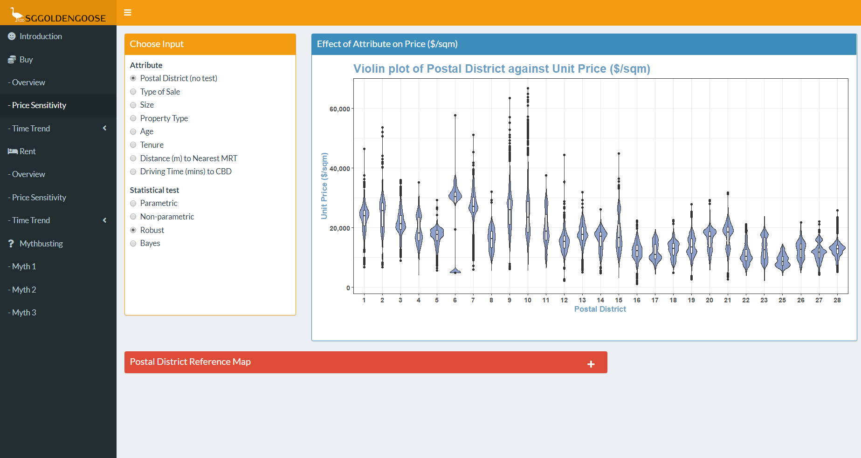
2. Buy
2.2 Price Sensitivity Tab
This tab allows you to visualize relationship of different characters of properties on the unit price ($/sqm).
07

Slide 10
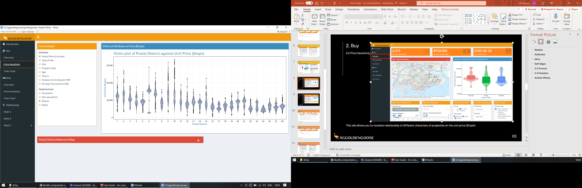
2. Buy
2.2 Price Sensitivity Tab – User’s interface
Choose the attribute that you would like to compare against unit price
Choose the type of statistical test to perform:
Tests are not available for postal district
For categorical (type of sale, size, property type, age and tenure) variables, the test determines if there is significant difference in the mean unit price of each group
For continuous variables (distance to nearest MRT, driving time to CBD), the test determines if the attribute chosen is linearly correlated to unit price
The plot will update according your chosen input from steps 1 and 2
1
2
01
08

Slide 11
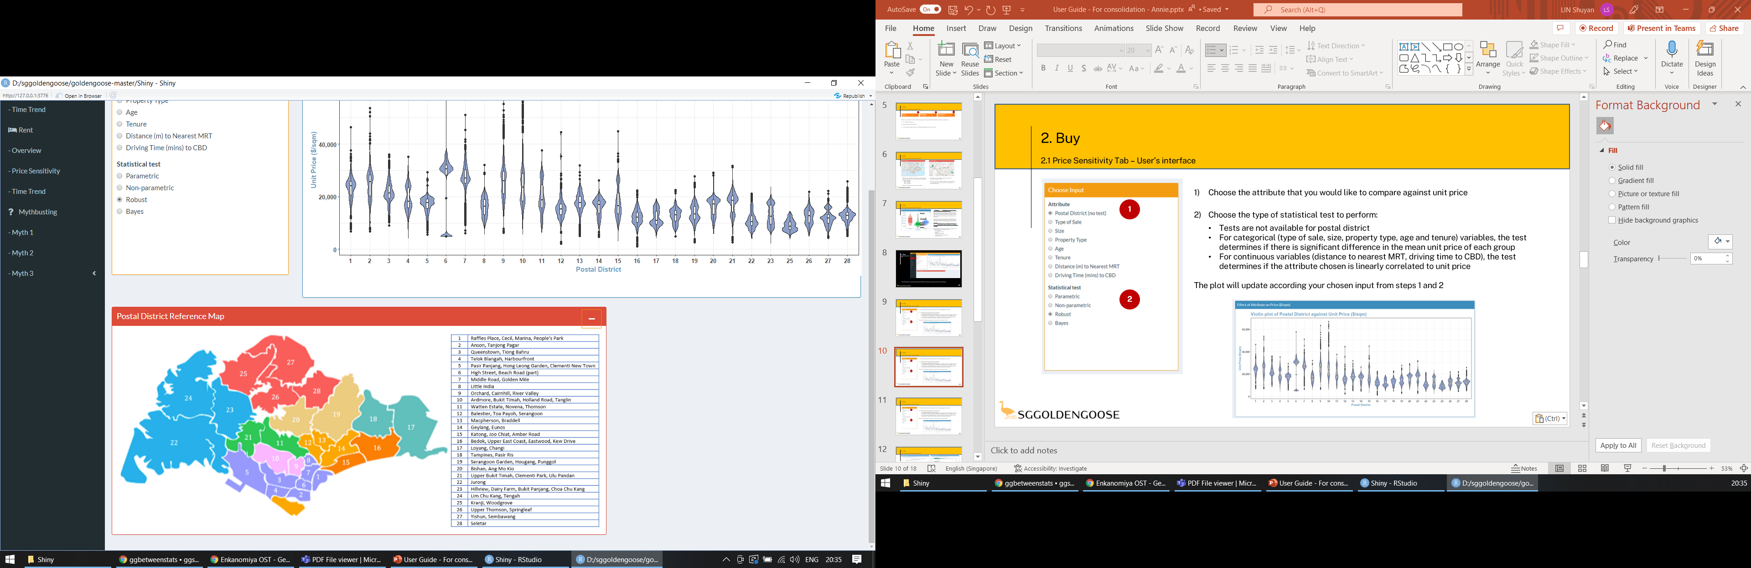
2. Buy
2.2 Price Sensitivity Tab – Reactive Visualization (1/3)
If postal district is chosen (default input), a violin box plot is shown.
The violin plot shows the distribution of unit price within each postal district.
The boxplot shows the inter-quartile range and median unit price within each postal district.
For easy reference, users can expand the collapsible postal district reference map at the bottom to view the geographical location of each postal district.
01
09

Slide 12
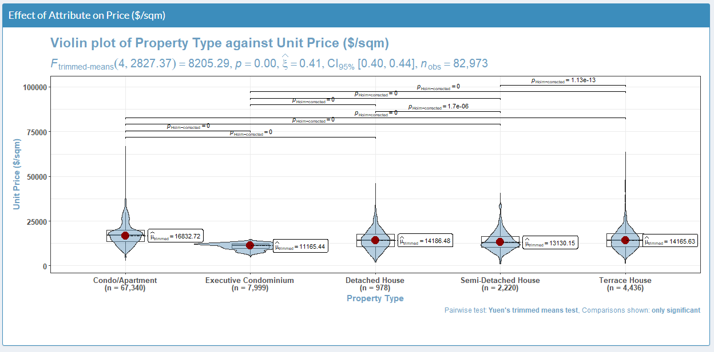
2. Buy
2.2 Price Sensitivity Tab – Reactive Visualization (2/3)
If a categorical variable is chosen, a violin plot is shown.
Pair-wise comparisons are performed and the lines above show pairs with statistically significant differences.
The red dot marks the centrality measure that is used in the chosen type of test.
Notes on interpretation
Statistical significance: The p-value (p in the subtitle) is a measure of the probability that the observed difference is due to pure chance and no underlying trends in the data. The lower the p-value, the greater significance of the observed difference. Usually, a p-value <0.05 is taken to mean that the result is statistically significant, and the observed difference is not by chance.
Pair-wise comparisons: The p-value in an analysis of variance (ANOVA) only tells us that the centrality measure (depends on the type of test) of at least one group is significantly different. The pair-wise comparisons compare all possible pairs of groups tested. We recommend using the robust test (default) as it is less influenced by outliers and violations of parametric ANOVA assumptions.
01
10

Slide 13
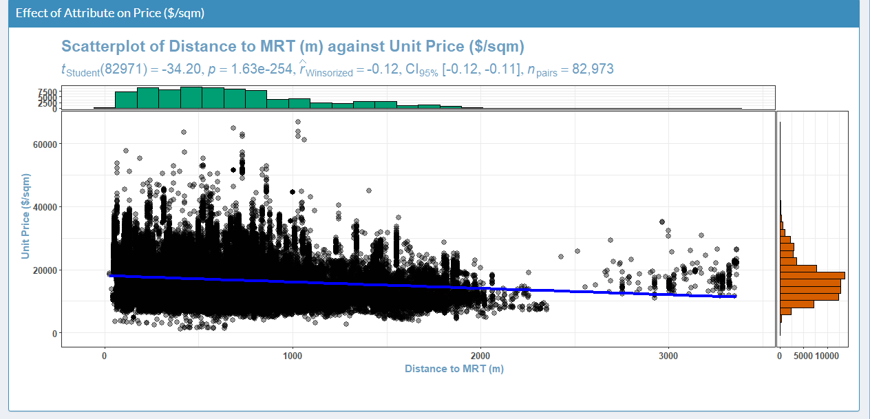
2. Buy
2.2 Price Sensitivity Tab – Reactive Visualization (3/3)
If a continuous variable is chosen, a scatter plot is shown.
The blue line shows the linear trend line between the chosen variable and unit price.
Marginal histograms show the distribution of values of each variable.
Notes on interpretation
Statistical significance: The p-value (p in the subtitle) is a measure of the probability that the observed trend is due to pure chance and not underlying trends in the data. The lower the p-value, the greater significance of the observed difference. Usually, a p-value <0.05 is taken to mean that the result is statistically significant, and the observed trend is not by chance.
We recommend using the robust test (default) as it is less influenced by outliers and violations of parametric linear regression assumptions.
01
11

Slide 14
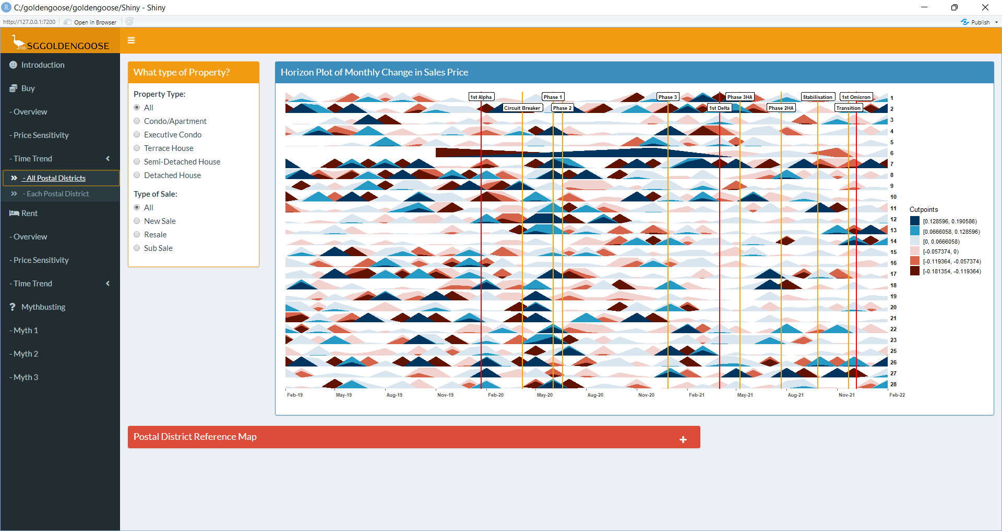
2. Buy
2.3.1 Time Trend Tab –
All Postal Districts
This tab allows you to visualize the monthly rate of change on the sales unit price ($/sqm) based on different property type and type of sale, across all postal districts.
12

Slide 15
2. Buy
2.3.1 Time Trend Tab – User’s interface
Choose the attributes (Property Type and Type of Sale) that you would like to compare against unit price
The horizon plot will update according your chosen input from steps 1 and 2
1
2
01
13

Slide 16
2. Buy
2.3.1 Time Trend Tab – Reactive Visualization
The horizon plot shows the change in median sales unit price ($/sqm) as compared to the previous month by postal district.
The origin of the horizon plot starts from 0. By default, the data is cut into 3 parts in the positive range, and 3 parts in the negative range, as shown in the chart legend. Rate of increase in price will be shown as different intensity of blue and rate of decrease in price will be shown as different intensity of red.
The vertical reference lines show the timeline of event of COVID measures in Singapore (e.g. Circuit Breaker, Heightened Alert). This allow users to observe the change in relation to the COVID situation.
For easy reference, users can expand the collapsible postal district reference map at the bottom to view the geographical location of each postal district.
01
14

Slide 17
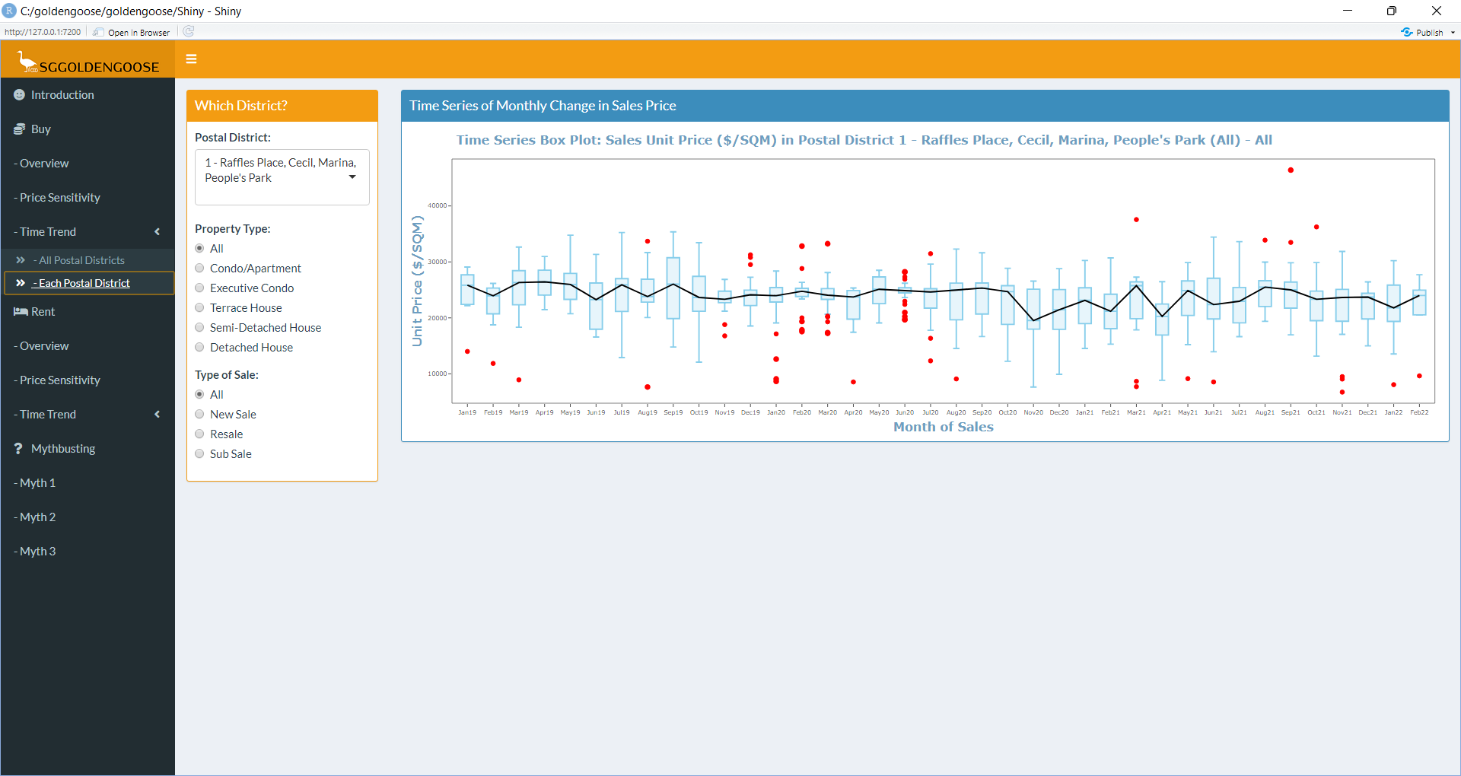
2. Buy
2.3.2 Time Trend Tab –
Each Postal District
This tab allows you to visualize the monthly rate of change on the sales unit price ($/sqm) based on different property type, type of sale and postal district.
15

Slide 18
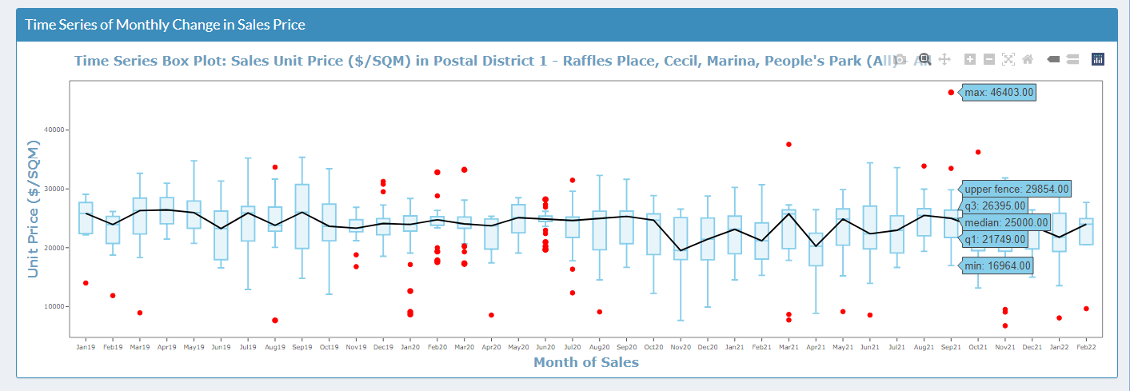
2. Buy
2.3.2 Time Trend Tab – User’s interface
Choose the attributes (Postal District, Property Type and Type of Sale) that you would like to compare against unit price
The time series box plot will update according your chosen input from steps 1, 2 and 3.
The tooltip will show the descriptive statistical information when you mouse over any point on the plot (e.g. min, median and max).
The red dots indicate the outlier sale unit price, and the black line shows the trend of the median price over the time period.
1
2
3
01
16

Slide 19
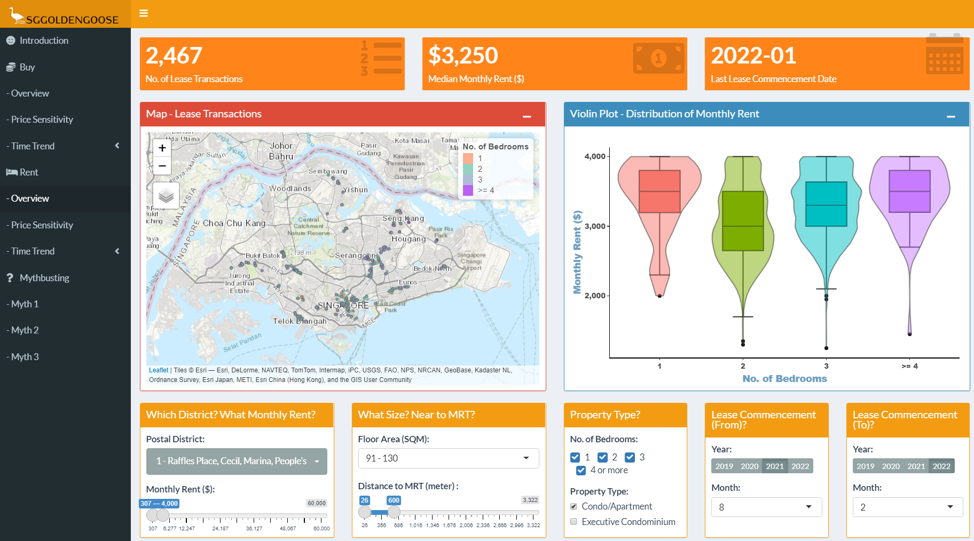
3. Rent
3.1 Overview Tab
This tab allows you to visualize a summary of the lease transaction prices and their distribution (i.e. mean, median etc), customized to your needs and preferences.
17

Slide 20
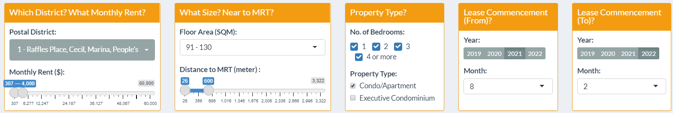
3. Rent
3.1 Overview Tab – User’s interface
1
2
3
4
05
Apply Postal District filter(s) to the lease transaction data. Indicate also the range of Monthly Rent ($) of your interest.
Select the range of Floor Area (SQM), and the range of Distance-to-MRT.
Use the checkboxes to select and filter the No. of Bedrooms and Property Tenure.
Indicate the date range of Lease Commencement Date for past least transactions, to retrieve relevant records for your reference.
01
18

Slide 21
3. Rent
3.1 Overview Tab – Reactive Visualization (1/3)
1
2
3
Based on your selection criteria, the following values will be populated instantaneously in the three value boxes:
No. of Lease Transactions
Median Monthly Rent ($); and
Last Lease Commencement Date captured in the REALIS database that fits your criteria.
01
19

Slide 22
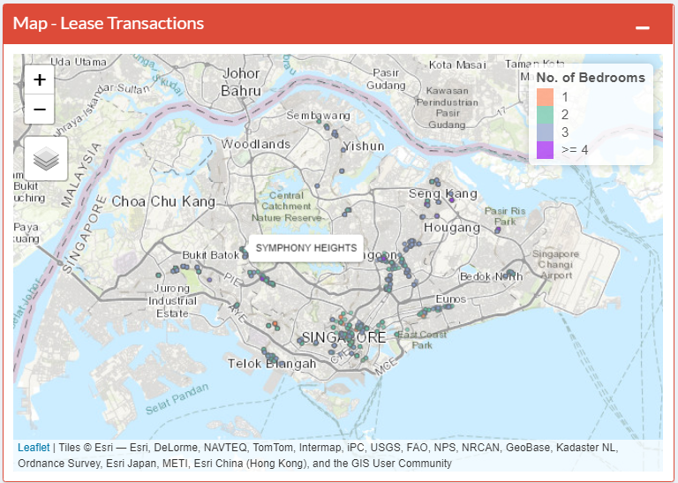
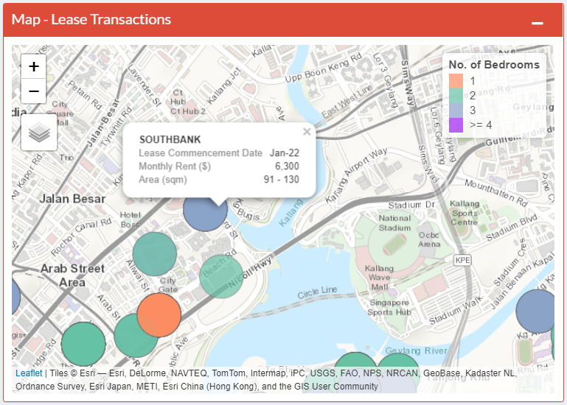
3. Rent
3.1 Overview Tab – Reactive Visualization (2/3)
Based on your selection criteria, dots representing past lease transaction with the following color-coding will appear on the map:
Red : 1 bed-room unit
Green : 2 bed-room unit
Blue : 3 bed-room unit
Purple : 4 bed-room unit
Mouse over the dots to see the property name.
- Zoom and pan into the map to have a closer look at
the property’s exact location.
Click over the dots to reveal the details of the transactions [i.e. Lease Commencement Date, Monthly Rent, Area (SQM)]
01
20

Slide 23
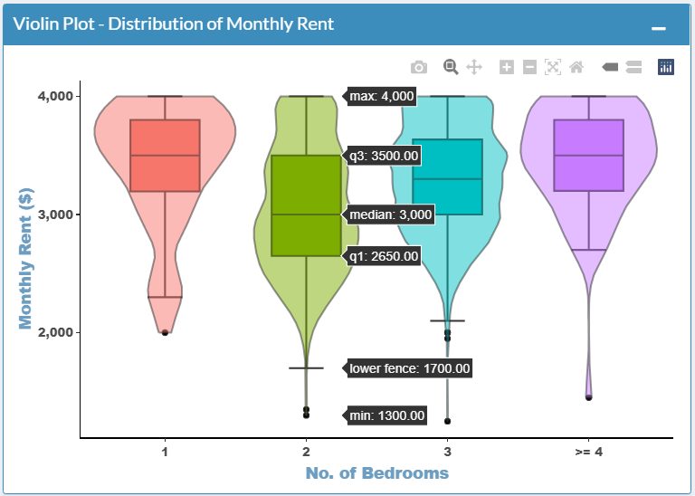
3. Rent
3.1 Overview Tab – Reactive Visualization (3/3)
A Violin plot depicts distributions of numeric data for one or more groups using density curves. In this case, the width of each curve corresponds with the approximate frequency of data points in each type of unit based on no. of bedrooms and the monthly rent. When moused over the violin plot, such density will be displayed.
The violin plot is accompanied by an overlaid box plot, which provide additional information of the distribution of Monthly Rent grouped by units with different no. of bedrooms.
Box plots are often used in explanatory data analysis to show the distribution of numerical data and skewness through displaying the data quartiles (or percentiles) and averages.
When we hover over the box plots, the summary of the Monthly Rent data is shown:
the minimum,
first (lower) quartile,
median,
third (upper) quartile,
upper and/or lower fence,
maximum score.
01
21

Slide 24
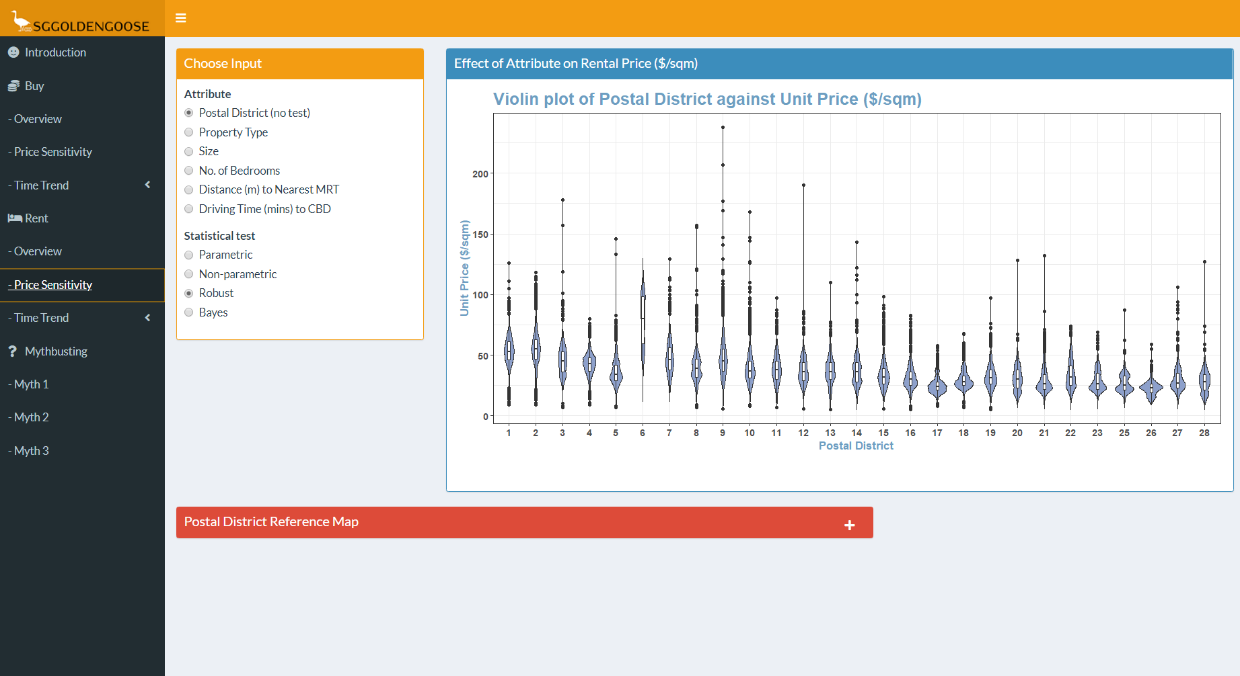
3. Rent
3.2 Price Sensitivity Tab
This tab allows you to visualize relationship of different characters of properties on the rental unit price ($/sqm).
22

Slide 25
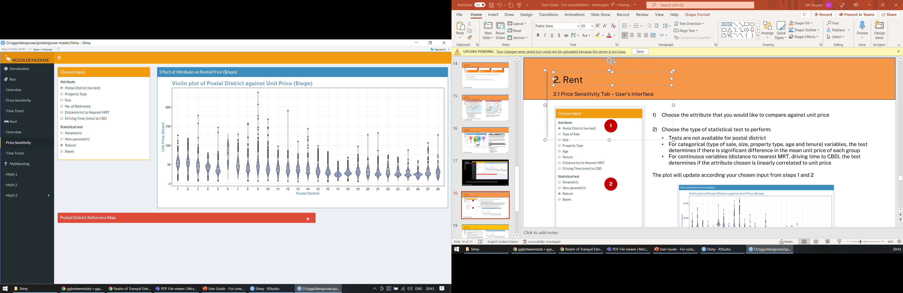
3. Rent
3.2 Price Sensitivity Tab – User’s interface
Choose the attribute that you would like to compare against unit rental price
Choose the type of statistical test to perform:
Tests are not available for postal district
For categorical (property type, size, age and no. of bedrooms) variables, the test determines if there is significant difference in the mean unit price of each group
For continuous variables (distance to nearest MRT, driving time to CBD), the test determines if the attribute chosen is linearly correlated to unit price
The plot will update according your chosen input from steps 1 and 2
1
2
01
23

Slide 26
3. Rent
3.2 Price Sensitivity Tab – Reactive Visualization (1/2)
If postal district is chosen, a violin box plot is shown.
The violin plot shows the distribution of unit price within each postal district.
The boxplot shows the inter-quartile range and median unit price within each postal district.
For easy reference, users can expand the collapsible postal district reference map at the bottom to view the geographical location of each postal district.
01
24

Slide 27
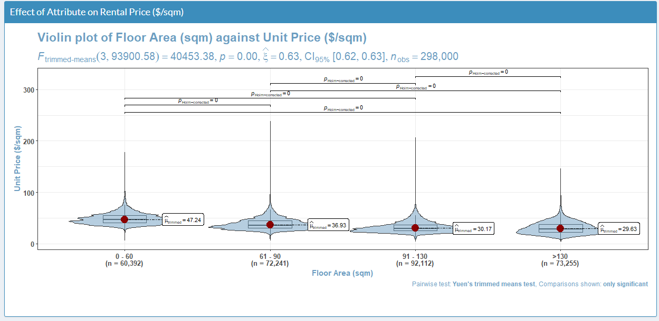
3. Rent
3.2 Price Sensitivity Tab – Reactive Visualization (2/3)
If a categorical variable is chosen, a violin plot is shown.
Pair-wise comparisons are performed and the lines above show pairs with statistically significant differences.
The red dot marks the centrality measure that is used in the chosen type of test.
Notes on interpretation
Statistical significance: The p-value (p in the subtitle) is a measure of the probability that the observed difference is due to pure chance and no underlying trends in the data. The lower the p-value, the greater significance of the observed difference. Usually, a p-value <0.05 is taken to mean that the result is statistically significant, and the observed difference is not by chance.
Pair-wise comparisons: The p-value in an analysis of variance (ANOVA) only tells us that the centrality measure (depends on the type of test) of at least one group is significantly different. The pair-wise comparisons compare all possible pairs of groups tested. We recommend using the robust test (default) as it is less influenced by outliers and violations of parametric ANOVA assumptions.
01
25

Slide 28
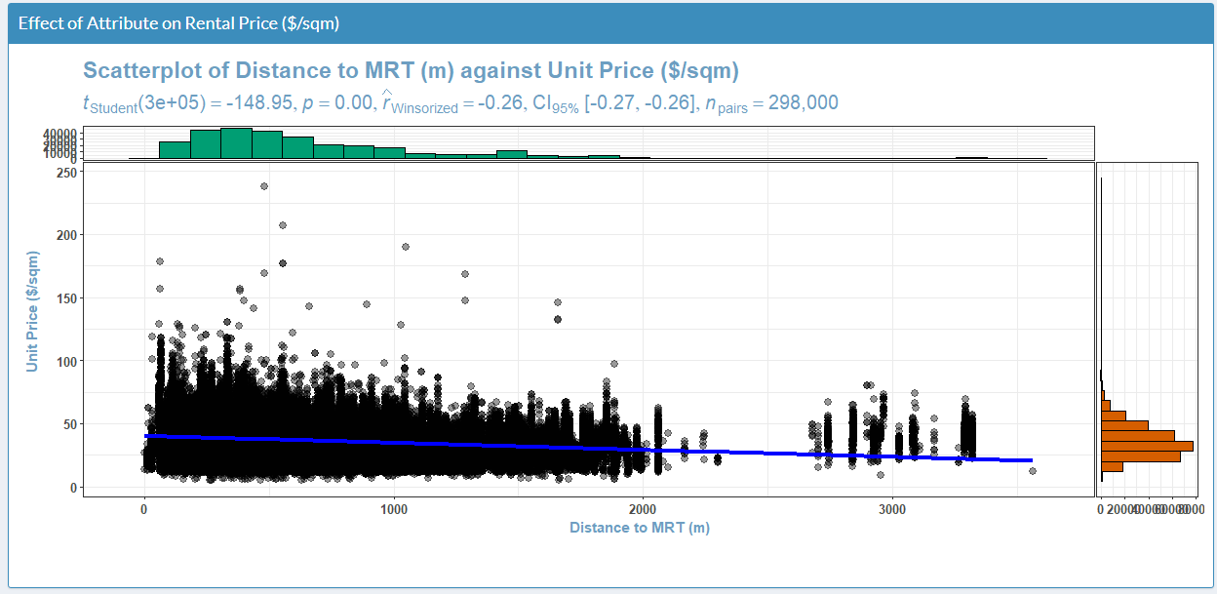
3. Rent
3.2 Price Sensitivity Tab – Reactive Visualization (3/3)
If a continuous variable is chosen, a scatter plot is shown.
The blue line shows the linear trend line between the chosen variable and unit price.
Marginal histograms show the distribution of values of each variable.
Notes on interpretation
Statistical significance: The p-value (p in the subtitle) is a measure of the probability that the observed trend is due to pure chance and not underlying trends in the data. The lower the p-value, the greater significance of the observed difference. Usually, a p-value <0.05 is taken to mean that the result is statistically significant, and the observed trend is not by chance.
We recommend using the robust test (default) as it is less influenced by outliers and violations of parametric linear regression assumptions.
01
26

Slide 29
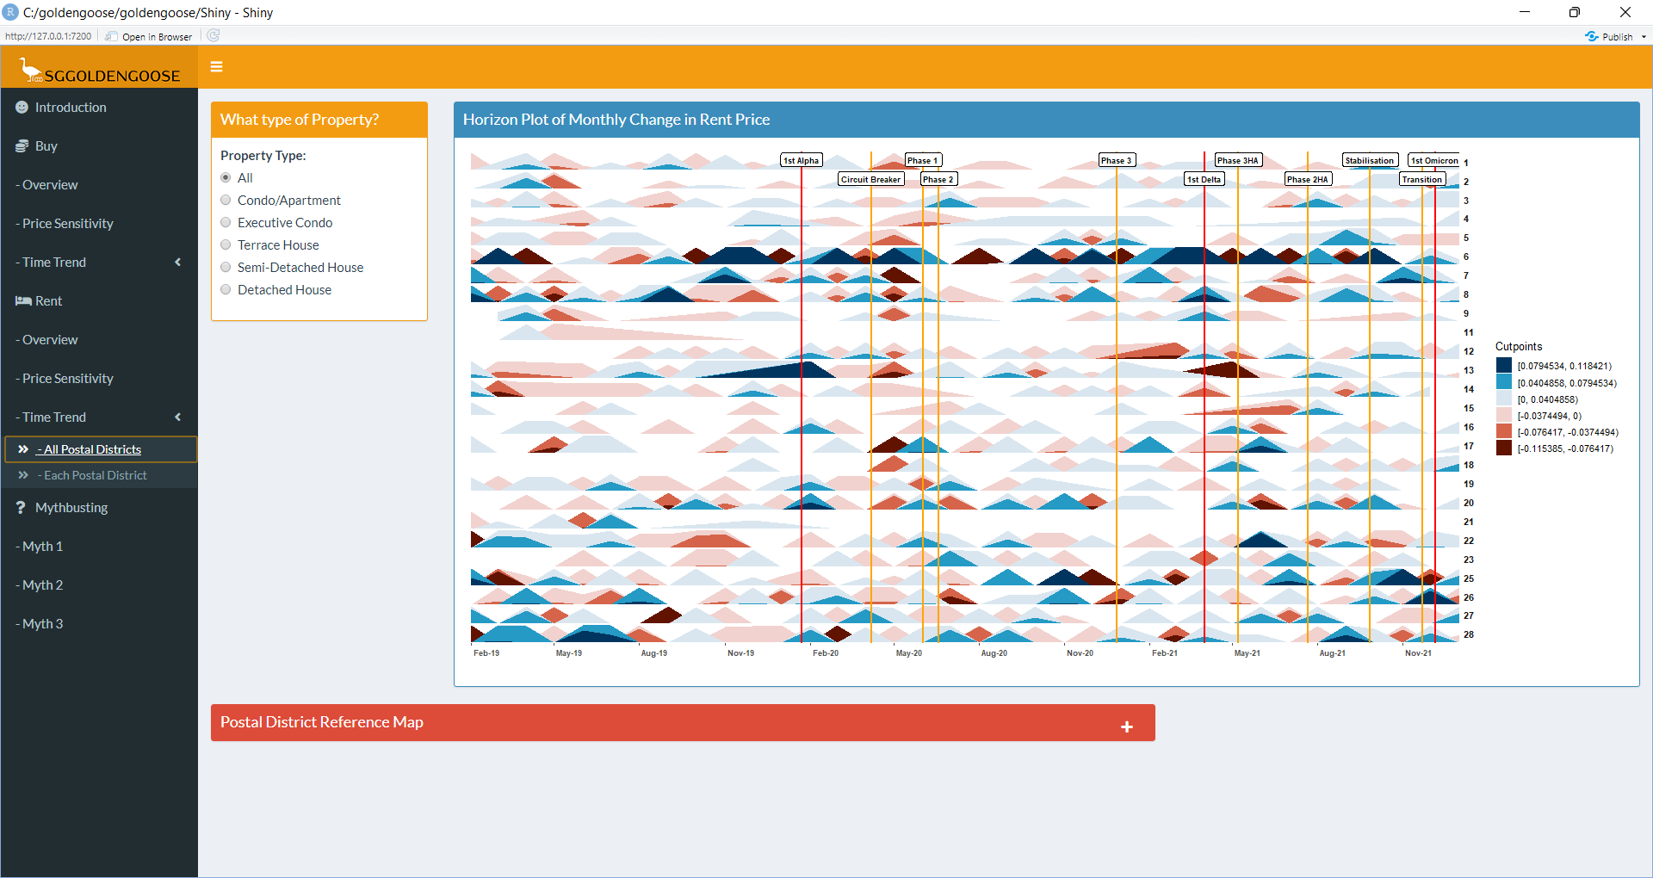
3. Rent
3.3.1 Time Trend Tab –
All Postal Districts
This tab allows you to visualize the monthly rate of change on the rental unit price ($/sqm) based on different property type, across all postal districts.
27

Slide 30
3. Rent
3.3.1 Time Trend Tab – User’s interface
Choose the attribute (Property Type) that you would like to compare against rental unit price
The horizon plot will update according your chosen input from step 1
1
01
28

Slide 31
3. Rent
3.3.1 Time Trend Tab – Reactive Visualization
The horizon plot shows the change in median rental unit price ($/sqm) as compared to the previous month by postal district.
The origin of the horizon plot starts from 0. By default, the data is cut into 3 parts in the positive range, and 3 parts in the negative range, as shown in the chart legend. The rate of increase in price will be shown as different intensity of blue and rate of decrease in price will be shown as different intensity of red. (e.g. darker red means higher decrease compared to lighter red)
The vertical reference lines show the timeline of event of COVID measures in Singapore (e.g. Circuit Breaker, Heightened Alert). This allow users to observe the change in relation to the COVID situation.
For easy reference, users can expand the collapsible postal district reference map at the bottom to view the geographical location of each postal district.
01
29

Slide 32
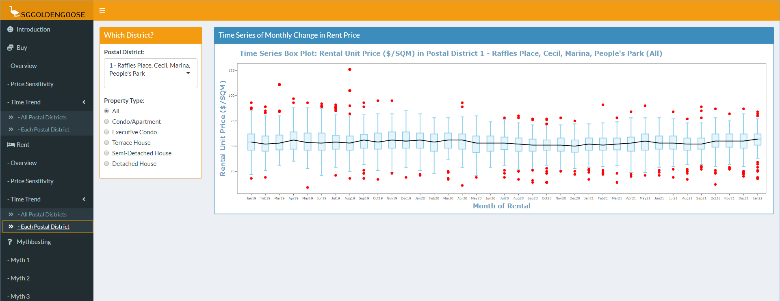
3. Rent
3.3.2 Time Trend Tab –
Each Postal District
This tab allows you to visualize the monthly rate of change on the rental unit price ($/sqm) based on different property type and postal district.
30

Slide 33
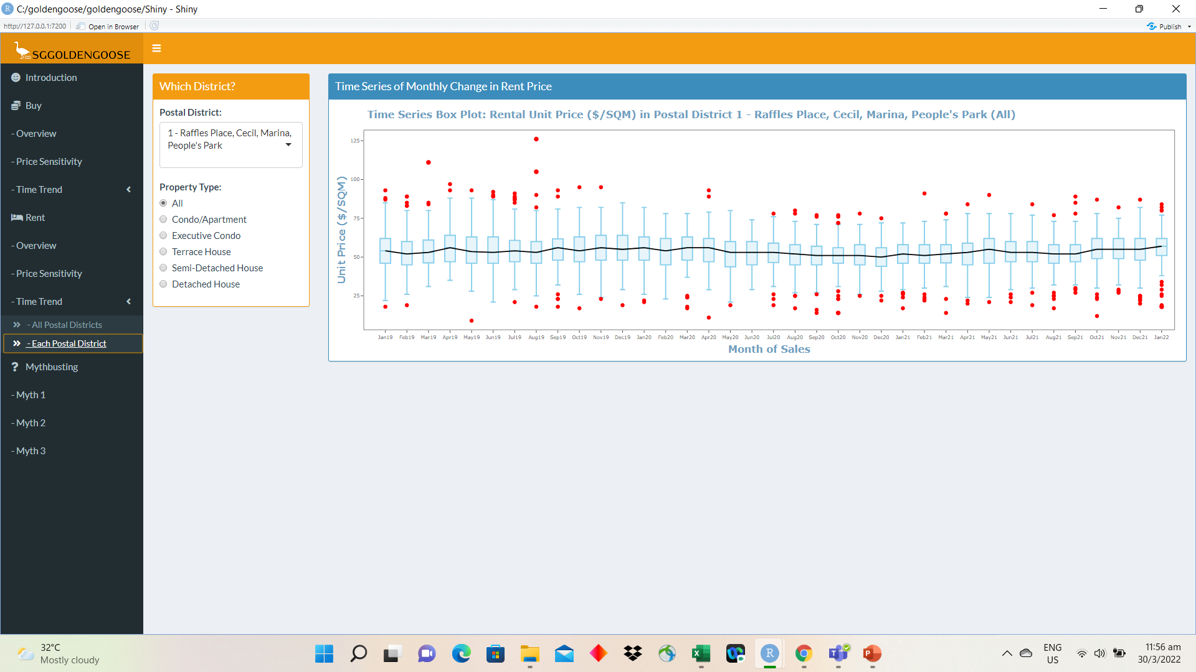
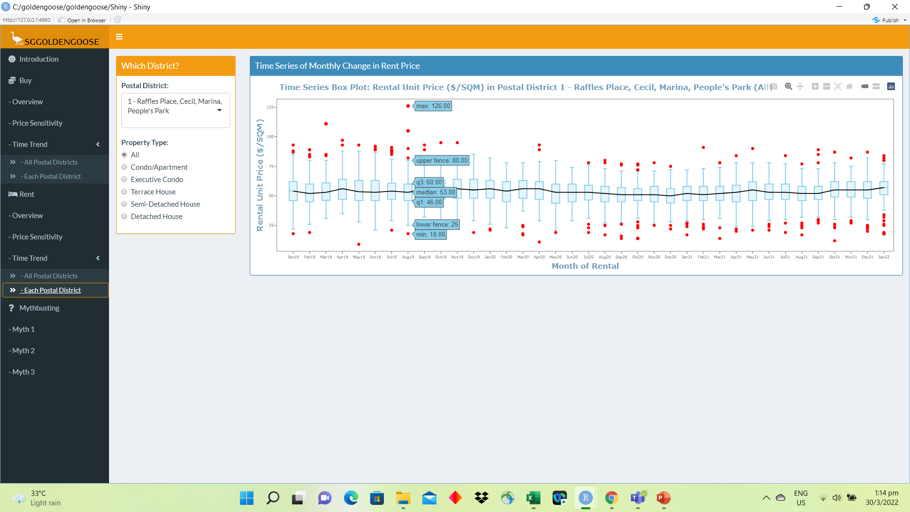
3. Rent
3.3.2 Time Trend Tab – User’s interface
Choose the attributes (Postal District and Property Type) that you would like to compare against rental unit price
The time series box plot will update according your chosen input from steps 1 and 2.
The tooltip will show the descriptive statistical information when you mouse over any point on the plot (e.g. min, median and max).
The red dots indicate the outlier rental unit price, and the black line shows the trend of the median rental price over the time period.
1
2
01
31

Slide 34
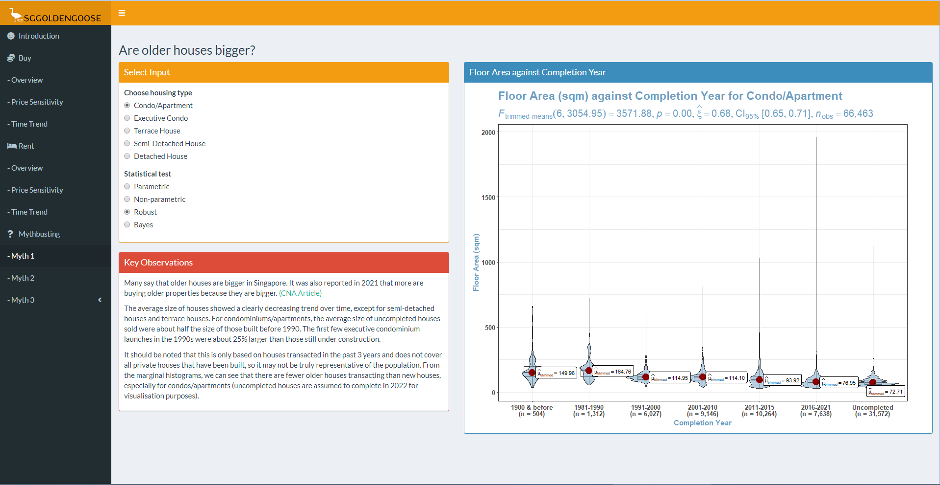
4. Mythbusting
The mythbusting tabs explore 3 interesting questions about private houses in Singapore using the sales transaction data.
Are older houses bigger?
Are some housing types more accessible than others?
Does pricing of new project launch changes overtime?
32

Slide 35
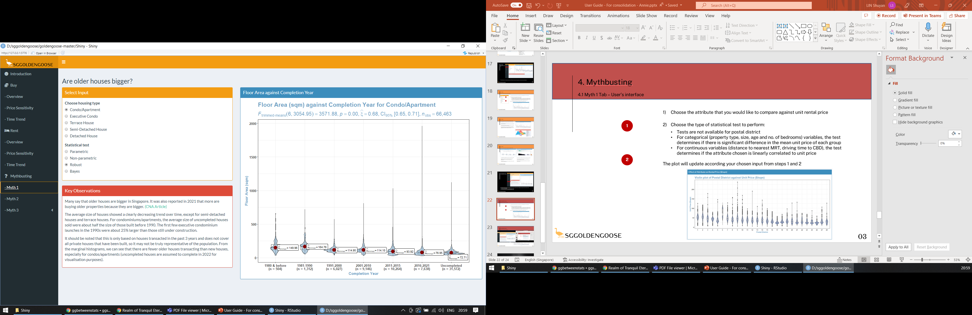
4. Mythbusting
4.1 Myth 1 Tab – User’s interface
Choose the type of housing you would like to study
Choose the type of statistical test to perform:
The statistical tests determine if the size of houses in each age group are statistically different.
The plot will update according your chosen input from steps 1 and 2
We have provided some analysis in the Key Observations box to answer the question of whether older houses really are bigger.
1
2
01
33

Slide 36
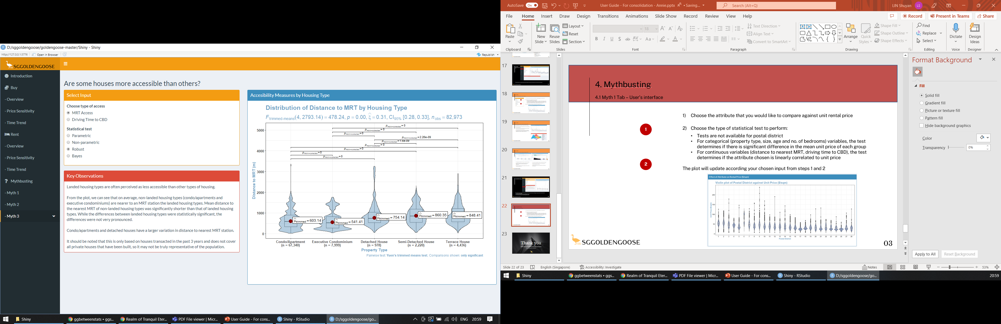
4. Mythbusting
4.1 Myth 2 Tab – User’s interface
Choose the type of accessibility measure you would like to study
Choose the type of statistical test to perform:
The statistical tests determine if the means of the chosen access measure are statistically different for each housing type.
The plot will update according your chosen input from steps 1 and 2.
We have provided some analysis in the Key Observations box to answer the question of whether some housing types are more accessible than others.
1
2
01
34

Slide 37
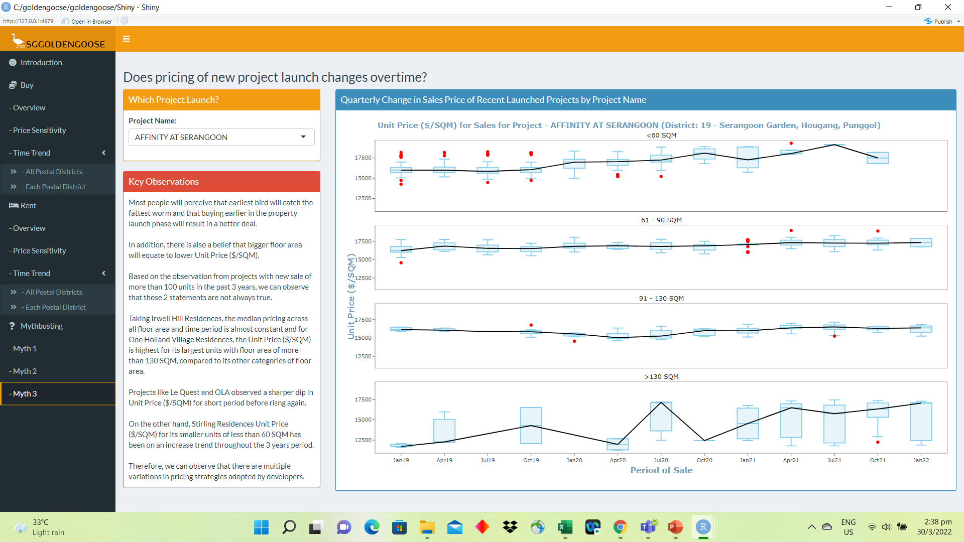
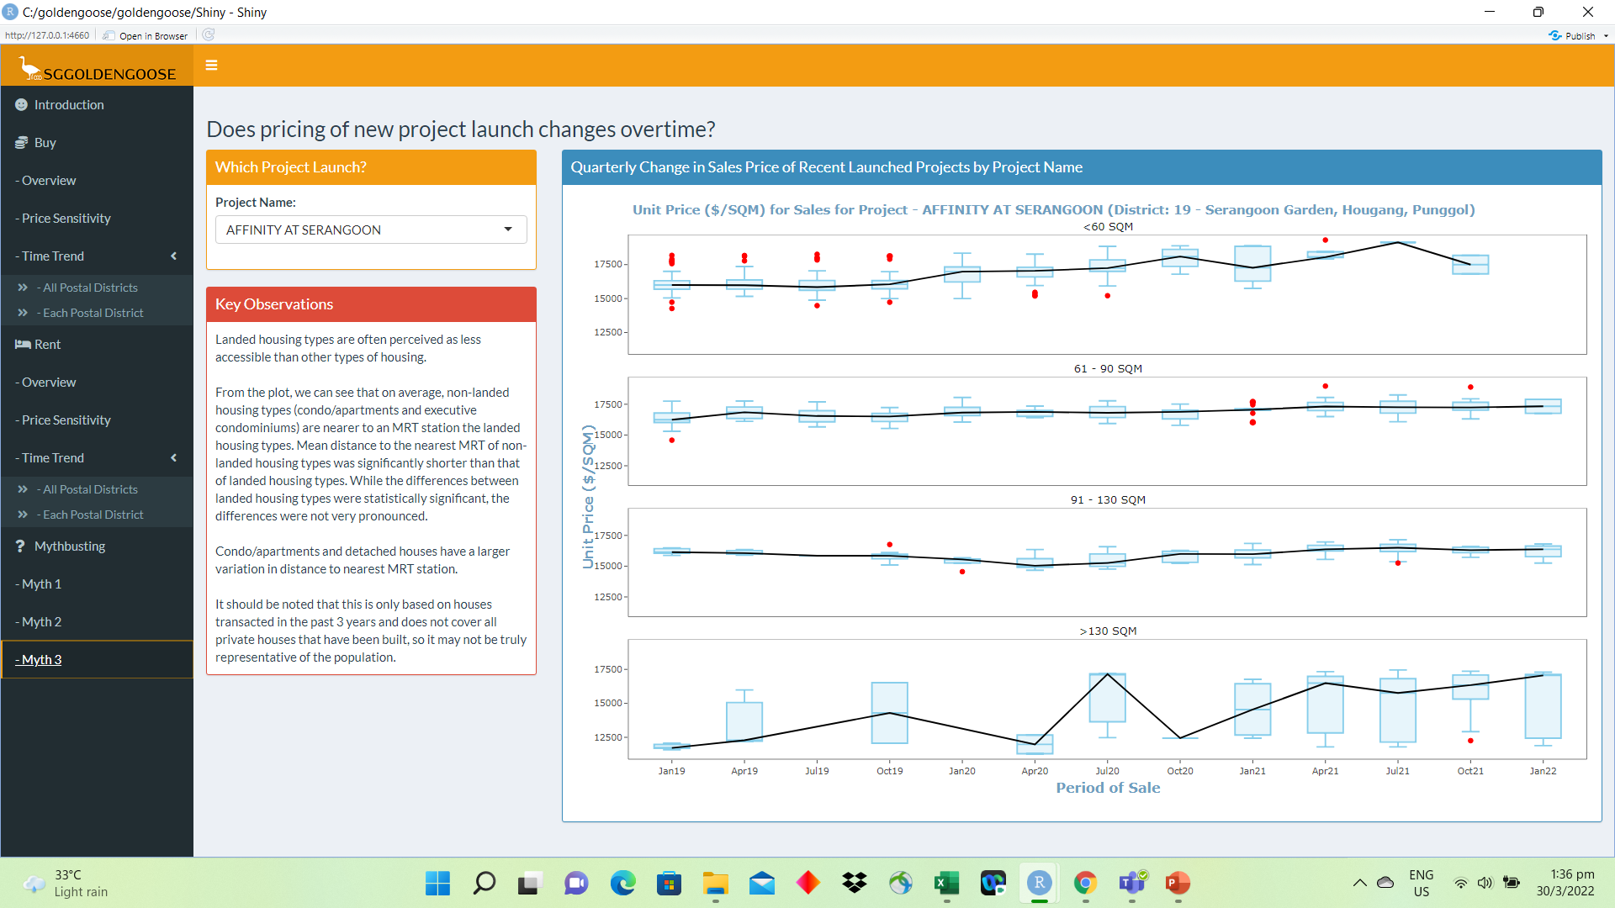
4. Mythbusting
4.1 Myth 3 Tab – User’s interface
Choose the Property Name that you would like to study
The plot will update according your chosen input from step 1.
To also give insight on whether the housing type in the project will affect the unit price over the time period, 4 sub-plots will be shown based on the binned floor areas (i.e. < 60 SQM, 61-90 SQM, 91 to 130 SQM and >130 SQM).
The tooltip will show the descriptive statistical information when you mouse over any point on the plot (e.g. min, median and max).
The red dots indicate the outlier sales unit price, and the black line shows the trend of the median sales price over the time period.
We have provided some analysis in the Key Observations box to answer the question of whether pricing of new project launch changes with time.
1
01
35

Slide 38

Thank you
May the goose be with you

